Slide 1
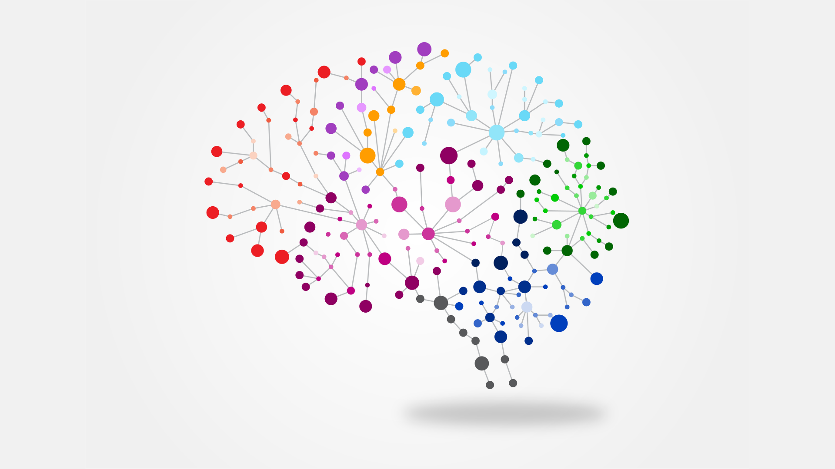

NEUROFEEDBACK GUI
Presented by:
Engr. Ammara Zahid
Research Assistant
NCAI-NEDUET

Slide 2
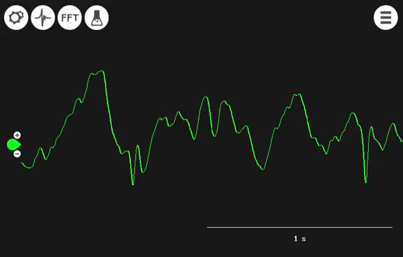

Slide 3
NEUROFEEDBACK
Using Technology to
Re-Shape the Mind

Slide 4
THE BIG
IDEA:
When you have information what your brain waves are doing, your brain can use that information to change how it works.

Slide 5
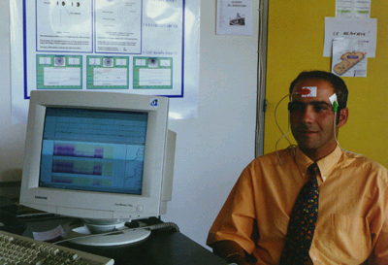
Computer can filter out the various brain wave frequencies & provide us with this information in a usable form.
Notes:
We can therefore look at what the brain is doing under each sensor.

Slide 6
What’s
Neurofeedback
good for??
Notes:
we are really in the early stages of exploring this amazing intervention

Slide 7
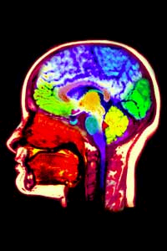
Beyond drugs: New option for the mentally ill in Pakistan
Neurofeedback works by helping to restore a better balance of waves in various parts of the brain.

Slide 8

Application domain
Neuro Psychological therapy
Cognitive Peak Performance

Slide 9
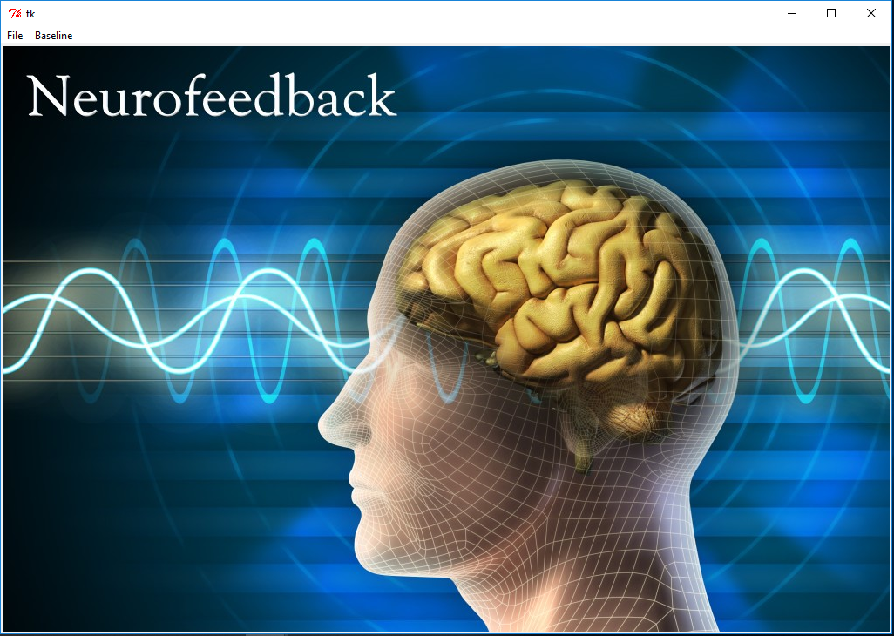
Product Introduction
This project aims at developing an interactive application for brain training, designing a real-time signal acquisition protocol, designing real-time signal processing and analysis protocols and developing an interface to visualize brain activity at real-time.

Slide 10
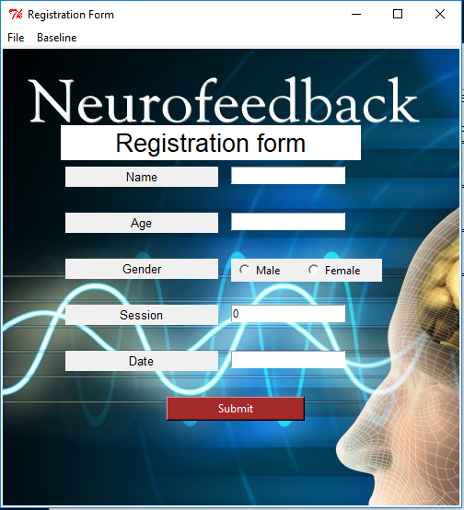

Parameter's included
Personal Portal

Slide 11
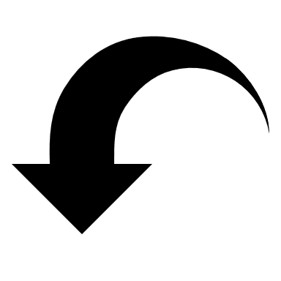
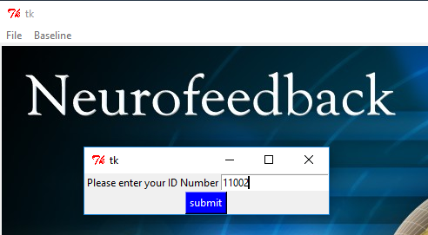
Personal login ID

Slide 12
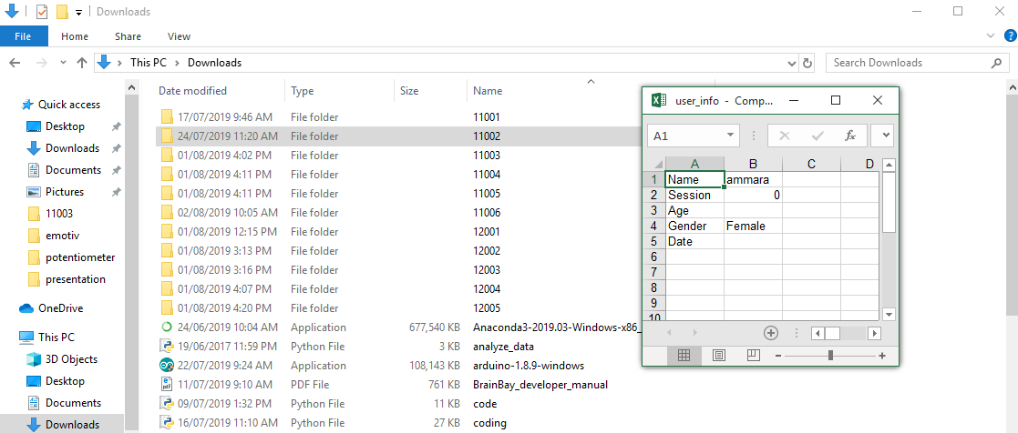

Slide 13

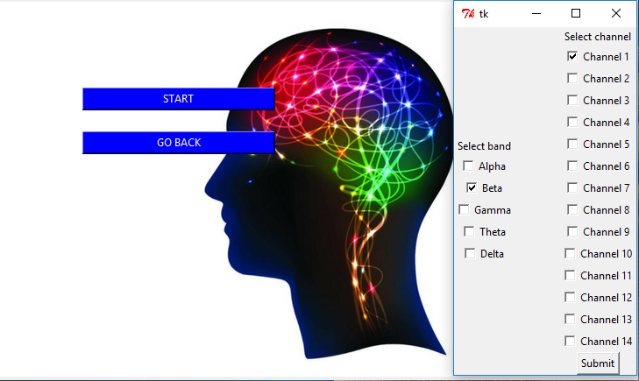
Selection options

Slide 14

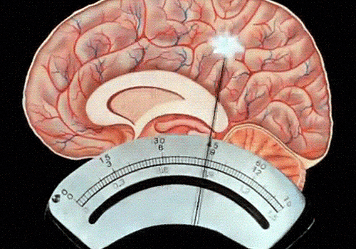
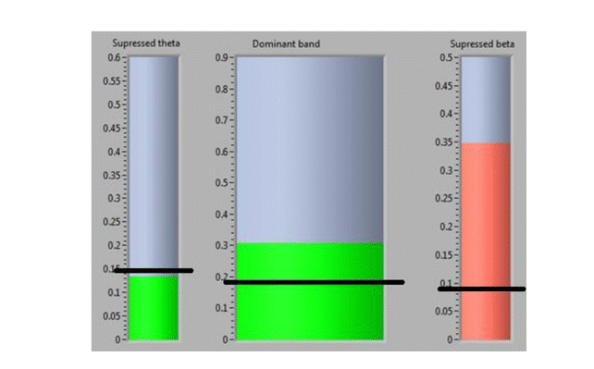
Training Sessions

Slide 15
Brain training is… exercising the brain – a mental workout.

Slide 16
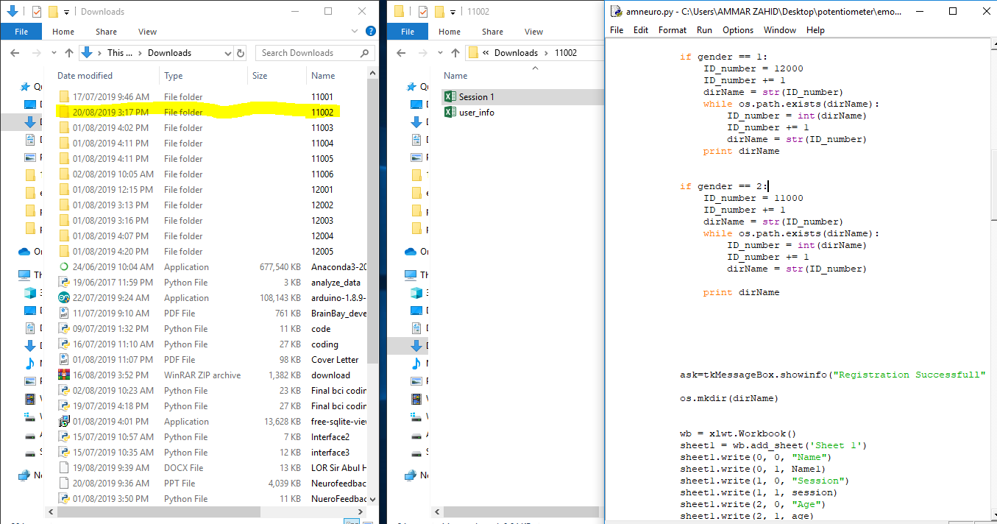

Slide 17
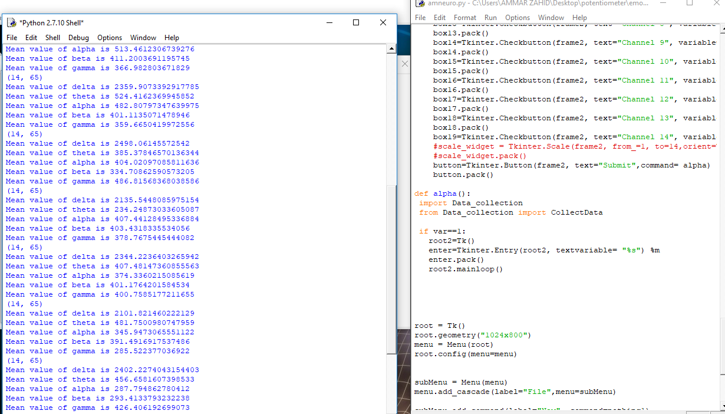

Slide 18
Neurofeedback POSITIVELY AFFECTS:
ADD/ADHD
ADDICTIONS
ANXIETY
LEARNING DISABILITIES
MIGRAINES
POST-TRAUMATIC STRESS
ASD

Slide 19

How long is the treatment?

Slide 20
Typical training is 2-3 times a week, for 15-30 minutes.
For many conditions,
40 sessions
will provide nearly permanent relief.
Notes:
There are alternative ways to train – some professionals offer very intensive training over a few days’ time with occasional booster sessions in the future. Kids with pervasive developmental problems may benefit from daily training.

Slide 21

Business start up
Launching Product
Events and workshop

Slide 22

Project Revenue
The cost of the neurofeedback system and software starts at approximately $4,000 from single channel neurofeedback system and varies from number of Channels, Protocol and Parameter’s.
A 2017 article in Bloomberg Businessweek reported that 30 sessions of 40 minutes each might come to a total of $2,200, plus a $250 initial assessment fee.
North America is the largest supplier of Neurofeedback System, with a production market share nearly 60% in 2016. Europe is the second largest supplier of Neurofeedback System, enjoying production market share nearly 20.5% in 2016.
In 2018, the global Neurofeedback market size was 37 million US$ and it is expected to reach 57 million US$ by the end of 2025, with a CAGR of 6.3% between 2019 and 2025.
System Cost
Session Cost
Existing Market
Market forecast

Slide 23

Contact details:
ammarazahid.az@gmail.com

